Slide 1


Sleep-Inspired Batch Learning
Ana Knutson, Liam Otten, Andrew Prudlow

Slide 2
Problem Statement
Most training occurs with batches of the same size
  What if this wasn't the case?
Deep Learning is biologically inspired
  Neurons represent neurons in the brain
What if batch sizes also represented how humans learn?
  Model batch sizes after sleep
  Mix “exploration” of small batch sizes with “stabilization” with big batch sizes
Notes:
Most deep learning training uses a fixed batch size throughout optimization. But the question we ask here is: what if that wasn’t the case?
Deep learning is already loosely biologically inspired—neurons are modeled after biological neurons in the brain. So we extend that analogy and ask: what if batch size also reflected how humans actually learn?
In humans, learning isn’t constant. We have periods of active exploration when we’re exposed to new information, and periods of consolidation during sleep where memories are stabilized.
We model this by varying batch size over time: small batch sizes represent exploration, introducing more noise and flexibility in learning, while large batch sizes represent sleep-like phases that reduce noise and stabilize what has been learned.
So instead of a fixed training regime, we alternate between exploration and stabilization, inspired directly by how biological learning works.

Slide 3

Prior Research
Don't decay the learning rate, increase the batch size - Samuel L. Smith, Pieter-Jan Kindermans, Chris Ying, Quoc V. Le
  The batch size has a loosely inverse relationship to the learning rate
The Effect of Network Width on Stochastic Gradient Descent and Generalization: an Empirical Study - Daniel S. Park, Jascha Sohl-Dickstein, Quoc V. Le, Samuel L. Smith
$$noise∼\frac{\text{learning} \text{rate}}{batch size}$$
Notes:
This slide summarizes findings from Smith et al. and Park et al. showing that instead of always decaying the learning rate, we can instead increase the batch size. This is because stochastic gradient descent noise scales roughly with this ratio of batch size to learning rate. This basically means that it isn’t these literal values that matter, but their ratio and the amount of noise the introduce.
In our sleep-inspired batch size model, we directly use this idea. We modulate batch size over time to control optimization noise. During ‘wake’ phases, modeling after when we are awake during the day, we use smaller batches to increase noise and exploration, again similar to us learning new things during the day. Then, during ‘sleep’ phases, we increase the batch size to reduce noise and stabilize representations of the things learned during the day as what traditionally occurs when we are sleeping.
This basically means that we’re taking the relationship shown here, in which noise is proportional to batch size over learning rate, and we are using it as the basis for our biologically or sleep-inspired training schedule.

Slide 4
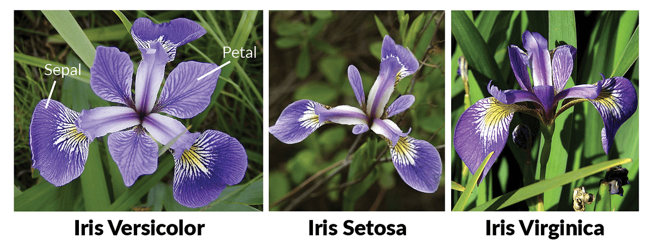
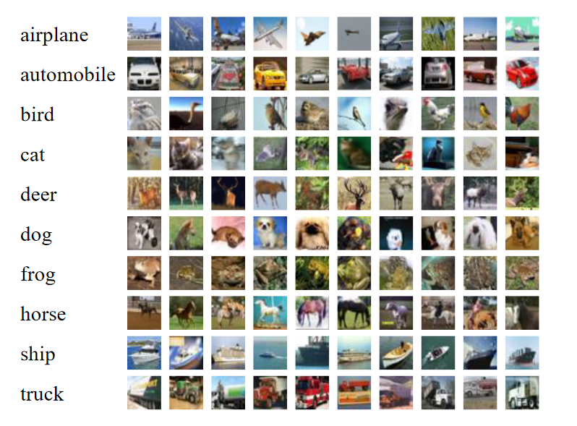
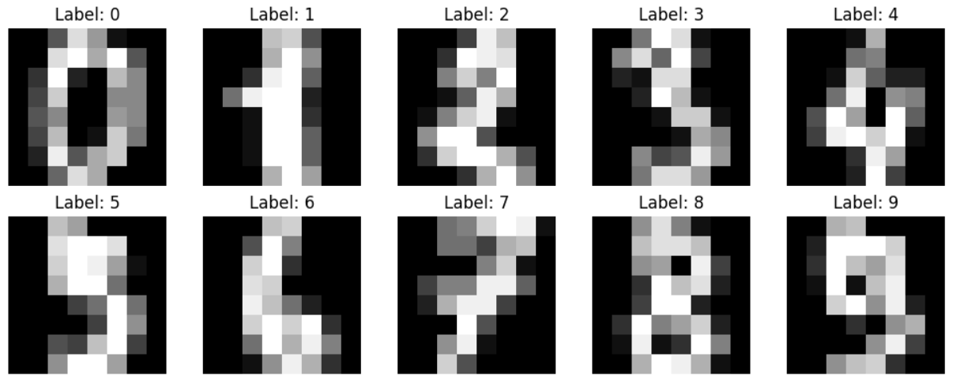
Datasets
Iris
CIFAR-100
Numbers
Notes:
We evaluate our sleep-inspired batch size approach across three standard benchmarks: Iris, MNIST-style handwritten digits (often referred to as the Numbers dataset) and CIFAR-100.
Iris is a small, structured dataset that lets us test whether the method works in simple, low-dimensional settings where decision boundaries are relatively clean.
The Numbers dataset, like MNIST, increases complexity by introducing high-dimensional image data of handwritten digits, where the model has to learn more abstract visual features.
Finally, CIFAR-100 is significantly more challenging, with 100 object classes and natural images, which tests whether our approach scales to complex, noisy real-world data.
Across these datasets, we use them to evaluate whether dynamically adjusting batch size (our sleep-inspired mechanism) can consistently improve learning stability and generalization across increasing levels of task difficulty.

Slide 5
Baseline Models
Iris: dense neural network
Digits: dense network + LeNet-style CNN
CIFAR-100: small ResNet-style CNN
Baseline used fixed batch size near the sleep-schedule average

Slide 6
Model Optimization Techniques
Sleep-inspired batch schedule: small batches with periodic large-batch “consolidation”
Data augmentation for CIFAR-100
SGD with momentum and step-decay learning rate
Compared against min-batch, max-batch, Adam, and sleep-inspired Adam

Slide 7
Baseline vs Improved Models
Iris: sleep schedule tied fixed batch baseline at 93.3%
Digits: sleep schedule improved 97.5% vs 96.4%
CIFAR-100: sleep-SGD improved 50.96% vs 48.50%
Small fixed batch performed best on CIFAR-100: 55.69%
Sleep-inspired Adam performed poorly: 24.97%

Slide 8
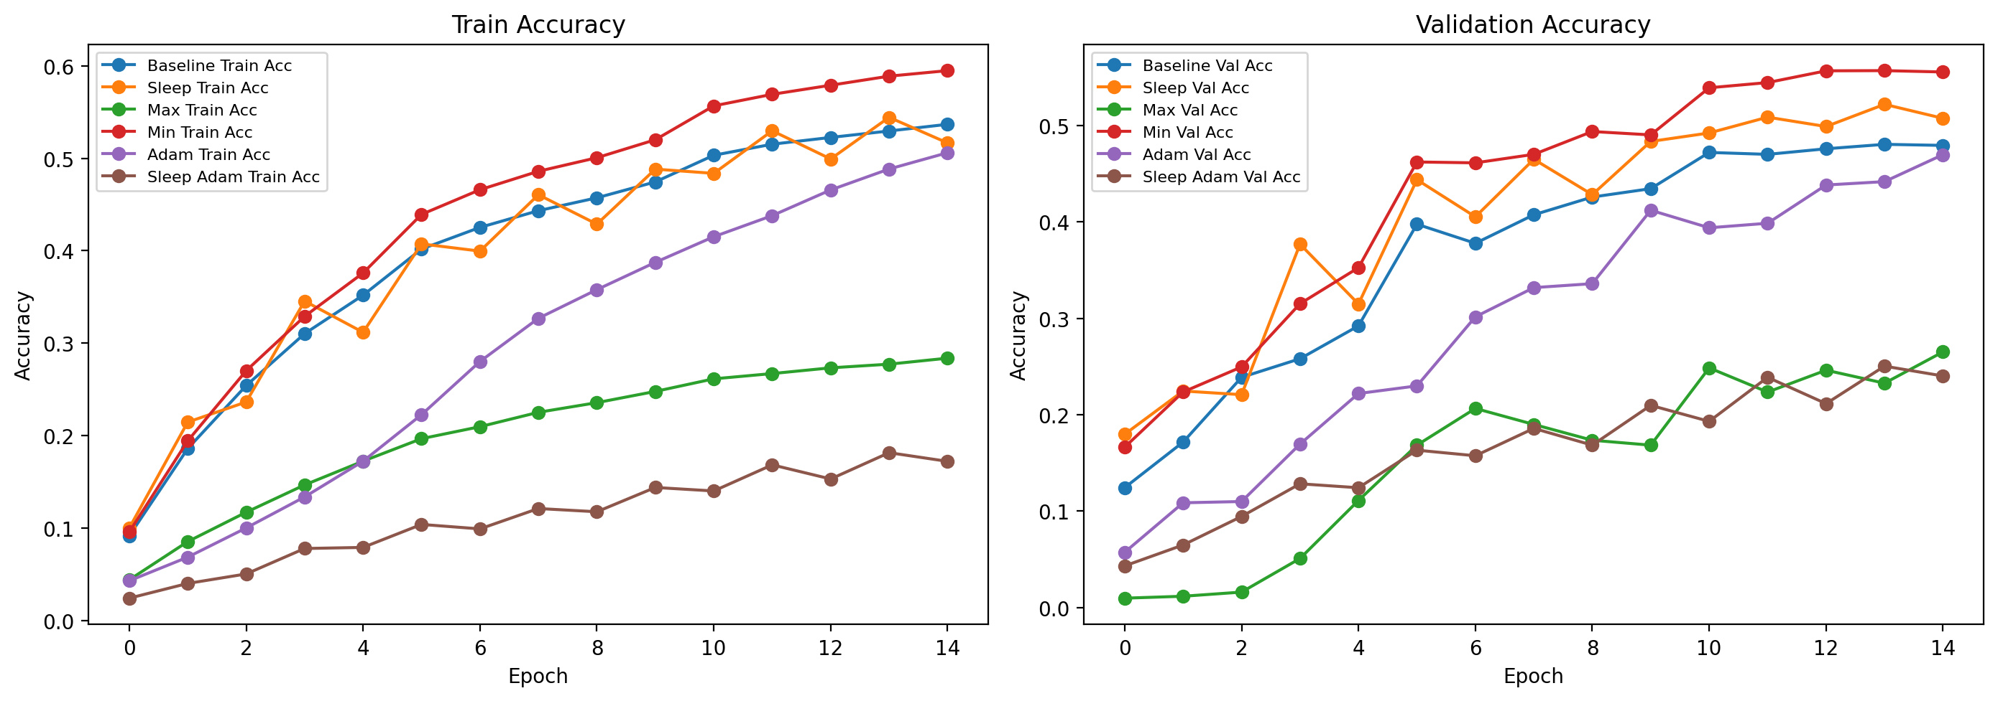
Results
Batch Schedule | Batch Size
Baseline Batch size | 138
Sleep-Inspired | [ 32 96 32 288 32 96 32 864 32 96 32 288 32 96 32]
Min Batch Size | 32
Max Batch Size | 864
Batch Schedule | Batch Size
Baseline Batch size | 69
Sleep-Inspired | [ 16 48 16 144 16 48 16 432 16 48 16 144 16 48 16]
Min Batch Size | 16
Max Batch Size | 432
Notes:
Lets take a look at what we are actually seeing in the CIFAR-100 dataset
We chose this dataset to do a deeper investigation because it is pretty complex and it will take a lot of epochs in order to actually converge to a steady score in most cases.
We generated our batch schedule with an algorithm -> it is a fractal pattern (‘ruler pattern’) that should nicely give us a large batch size in the middle of training, and then smaller versions of itself every time you halve it. This gives us small batch sizes interspersed with larger ones.
The baselines here are just the average of the whole fractal sequence.
What I see when I look at this is that our training curve follows the baseline (average) quite closely, however it surpasses it in validation accuracy in both of these experiments. This is really interesting to me. We can see that the small constant batch size beats everything, which implies we need more hyperparameter tuning for our sleep validation to win out.
We will include this in our future work, but since these took a while to run, we ran out of time tweaking it, but I think the success with the validation is key.
We can also see that slapping our schedule onto the Adam optimizer performed the worst. This experiment was out of curiosity, but was ultimately set to fail because Adam updates learning rate after every batch so it would require some tuning to theoretically be more effective.

Slide 9
Results cont.
Batch Schedule | Batch Size
Baseline Batch size | 138
Sleep-Inspired | [ 32 96 32 288 32 96 32 864 32 96 32 288 32 96 32]
Min Batch Size | 32
Max Batch Size | 864
Method | Accuracy | Test Loss
Baseline | 0.4850 | 1.9338
Sleep-Inspired | 0.5096 | 1.7968
Min Batch | 0.5569 | 1.6228
Max Batch | 0.2652 | 2.9037
Adam Baseline | 0.4738 | 2.0673
Sleep-Inspired Adam | 0.2497 | 2.9433
Batch Schedule | Batch Size
Baseline Batch size | 69
Sleep-Inspired | [ 16 48 16 144 16 48 16 432 16 48 16 144 16 48 16]
Min Batch Size | 16
Max Batch Size | 432
Method | Accuracy | Test Loss
Baseline | 0.5127 | 1.7926
Sleep-Inspired | 0.5082 | 1.8006
Min Batch | 0.5453 | 1.6772
Max Batch | 0.3419 | 2.6000
Adam Baseline | 0.4368 | 2.1034
Sleep-Inspired Adam | 0.0100 | 4.6110
Notes:
So heres our metrics for the two tests from the last slide
We see that for the first schedule that our model performs better than the baseline on the test set.
For the second test, Despite validation being higher, the test is about half a percent better than our model. This exposes that more work is definitely required and it is difficult to make 100% conclusions

Slide 10
Conclusions
Variable batch sizing can improve over a fixed average batch
Benefits are optimizer- and dataset-dependent
Small batches may matter more than the sleep analogy itself
The hypothesis is promising but not fully proven
Notes:
However, this is what we CAN conclude.
Variable batch sizing like ours can improve a model over a fixed batch.
The sizes would need a bit of tuning in line with the optimizer and dataset – it is a slightly brittle in that regard
The small batch size might matter more than the sleep itself
Ultimately our results are inconclusive. We cannot say without more testing that our sleep-inspired batch scheduling is beneficial, but we can say that it SEEMS that it improves validation and therefore overfitting in training.

Slide 11
Limitations/ Future Work
Run more experiments with our architecture
Run for very high number of epochs
Try CIFAR-10 instead of CIFAR-100 for an intermediate benchmark
Test more schedules and architectures
Tune learning rate jointly with batch size
Notes:
We would like to run more experiments with our architecture – A big question is if we get the optimal constant batch size, will the sleep schedule still outperform?
Equalize the number of gradient updates across
Run for Longer
How does our schedule affect training over a long time?
Try on a slightly simpler dataset
May make results more deterministic
Test more schedules and architectures
- Is our strategy generalizable?
Tune LR jointly with batch size
Figure out how to make it work with Adam/optimizers

Slide 12
Thank You! Any Questions?

